Slide 1
COP 3502 Introduction
Dr. Neslisah Torosdagli

Slide 2
About Me
Graduated from Computer Engineering Department of METU in Ankara, TURKEY,
Top third University in Turkey
Got MS and PhD degrees in CS at UCF,
Worked in a wide-range of companies in the industry,
Currently I am a Member of Technical Staff at AMD and working in the Vulkan driver development,
Anyone interested in an internship position at AMD, please do not hesitate to contact me.
Office Hours:
1 hour right after class

Slide 3
Goals
Improving knowledge of standard data structures and abstract data types.
Improving knowledge of standard algorithms used to solve several classical problems.
Covering some mathematics that is useful for the analysis of algorithms.
Analyzing the efficiency of solutions to problems.

Slide 4
Long Term Goals
Foundation Exam
Well-educated and successful UCF graduates in the industry

Slide 5
Must-Do
Read foundation exam:
Foundation Exam – Department of Computer Science (ucf.edu)
Financial Aid Requirement Quiz – must complete by Friday (01/13/2023).

Slide 6
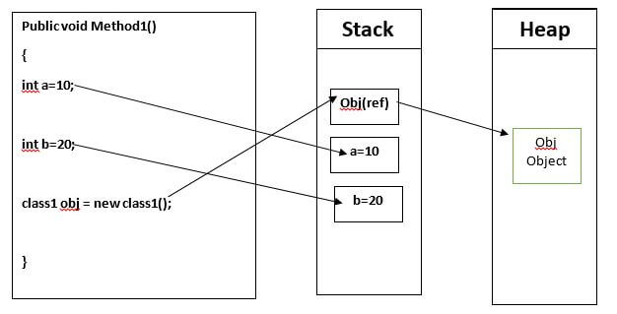
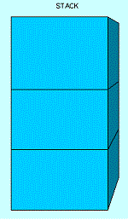
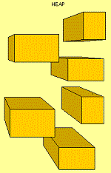
Memory – Stack vs Heap
STACK It is an array of memory.. It is a LIFO (Last In First Out) data structure. Data can be added to and deleted only from the top of it. | HEAP It is an area of memory where chunks are allocated to store certain kinds of data objects. Data can be stored and removed in any order.

Slide 7
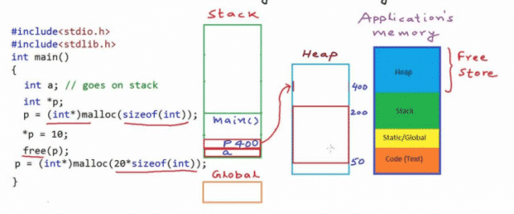



Memory – Stack vs Heap

Slide 8
Memory – Stack vs Heap
Every variable has a memory address
Every variable you declare in C is designed to hold a particular type of data. While the variable a in the code above was designed to hold an integer, the variable p was declared to hold the address of an integer. That's all a pointer is: a place to store a memory address.
int i = 22; // create an integer variable of size 32 bits
int *p; // create an integer pointer, in stack 32-bits space is allocated, in heap 32-bits space is allocated
p = &i; // Assign the address of 'i' to 'p’.
printf("(value) i: %d\n", i); // print value of i
printf("(addr) &i: %p\n", &i); // print address of i
printf("(value pointed) p: %d\n", *p); // print value of p
printf("(value) p: %p\n", p); // print address of p
printf("(addr) &p: %p\n", &p); // print address of p

Slide 9
Memory – Stack vs Heap
Pros and Cons:
Stack
very fast access
don't have to explicitly de-allocate variables
space is managed efficiently by CPU, memory will not become fragmented
local variables only
limit on stack size (OS-dependent)
variables cannot be resized
Heap
variables can be accessed globally
no limit on memory size
(relatively) slower access
no guaranteed efficient use of space, memory may become fragmented over time as blocks of memory are allocated, then freed
you must manage memory (you're in charge of allocating and freeing variables)
variables can be resized using realloc()

Slide 10
Pointers – Be Careful
You have to be careful about asterisks when declaring pointers!
Check out the key difference between these three declarations:
int *p, q, r;
int* p, q, r;
int *p, *q, *r;

Slide 11
Pointers
int i;
int *p = &i;
*p = 42;
printf("The value of i is now: %d\n", i);

Slide 12
Segmentation Faults
Your programs hang or crash as a result of weird pointer errors in your code.
When you access memory that is out of bounds for that program ­­ i.e., to go outside of the portion of memory that has been "segmented" off for it, it will crash.
Dereferencing an uninitialized pointer
int *p;
*p = 56;
Dereferencing a NULL pointer
int *p = NULL;
*p = 56;
Memory Leaks

Slide 13
Memory Leaks
Memory which is no longer needed is not released
Exhaust available system memory as an application runs
When all the memory on a system is exhausted, any attempt to allocate more memory will fail. This usually causes the program attempting to allocate the memory to terminate itself, or to generate a segmentation fault.
Memory leaks are not easy to resolve

Slide 14
Code Defensively
Always initialize all variables and pointers
Initialize pointers to NULL
Write code that won't crash with a nasty segfault, but which will instead give us useful error messages,
int i=0;
int *p = NULL;
if (p != NULL)
*p = 56;
else
printf("WARNING! It looks like you forgot to give p a valid integer address!\n");

Slide 15


Problem#1
There are n persons in a line
For a task, you need a person of height 5’3’’
How are you going to find this person?

Slide 16
Problem#1
Brute-Force:
Loop through the list of n persons until a person of height 5’3’’ is found
What will be the cost of searching?

Slide 17
Problem#1
Sort data
Do a binary search
What will be the cost of sorting and cost of searching?

Slide 18
Problem#2
You are given an nxn integer array where each row is filled with several 1s followed by all 0s. The goal of the problem is to determine the maximum number of 1s in any row.
1 | 1 | 0 | 0 | 0 | 0
0 | 0 | 0 | 0 | 0 | 0
1 | 1 | 1 | 0 | 0 | 0
1 | 1 | 1 | 0 | 0 | 0
1 | 1 | 1 | 1 | 1 | 0
1 | 1 | 1 | 1 | 0 | 0

Slide 19
Problem#2
For each row
Count the number of 1’s until the first 0 is encountered
If max_1’s is larger than count, assign max_1 to count
Continue to the next row
int max_1 = 0;
for (int r=0;r<n;++r)
{
int count = 0;
for (int c=0;c<n;++c)
{
if arr[r,c] == 0
break;
count++;
}
if (max_1 < count)
max_1 = count;
}

Slide 20
Problem#2
Cost of this computation:
If the array is all 0’s: O(n) - linear
If the array is all 1’s: O(n²) - quadratic
What if this is a question asked in a programming computation and n is very large, this brute-force method will most probably cause time-out ☹

Slide 21
Problem#2
Initialize the current row and current column to 0.
While the current row is less than n (or before the last row)
While the square at the current row and column is 1, Increment the current column.
Increment the current row.
The current column index represents the maximum number of 1s seen.
int r = 0;
int c = 0;
int max_1 = 0;
while (r<n)
{
while ((c<n) && (arr[r,c] == 1))
++c;
max_1 = c;
++r;
}

Slide 22
Problem#2
1 | 1 | 0 | 0 | 0 | 0
0 | 0 | 0 | 0 | 0 | 0
1 | 1 | 1 | 0 | 0 | 0
1 | 1 | 1 | 0 | 0 | 0
1 | 1 | 1 | 1 | 1 | 0
1 | 1 | 1 | 1 | 0 | 0
1
1
0
0
1
0
0
1
1
0
0

Slide 23
Problem#2
Cost of this computation:
If the array is all 0’s: O(n)
If the array is all 1’s: O(2n)=O(n) – linear, when n is sufficiently large, 2 is negligible.

Slide 24
Implementing an algorithm in C
In this class, you will improve your capability to implement an algorithm in C.
The more you exercise, the better you are
https://open.kattis.com/
https://codeforces.com/
In the beginning, it is always acceptable to propose a brute-force algorithm
Do not hesitate to implement the brute-force solution – take it as an opportunity to exercise
By time and experience you will:
Propose an efficient algorithm for a specific problem
Propose correct data-structures for the proposed algorithm
Propose general layout of your program, functions that needs to be implemented
Learn to code defensively - run-time errors to protect against
Learn how to deal with the corner cases – never assume regular conditions in your program to occur

